Slide 1
The 13 Colonies Part 1- The Purpose of Government and the Rights of Citizens

Slide 2
Why do we have rules in school?
How are the rules in school the same as the laws of a government?

Slide 3
The purpose of government is to:
1) Maintain order
2) Promote the general welfare
3) Protect the safety of citizens
4) Safeguard the rights of citizens

Slide 4
It does this by passing laws and raising money through taxes to pay for the operation and services of the government.

Slide 5
A law is a rule that tells people in a community, state, or country how they should behave. They create order and safety for people.

Slide 6
Revenue is money that a government receives from taxes and other sources in order to provide public goods and services to citizens.

Slide 7
Examples of Services provided by the government are:
-Protection through the army and police.
-Education through schools.
-Building and maintenance of roads and highways.
-Recreational areas like parks and natural areas.

Slide 8
A right is something you are ALLOWED to do or have by law.

Slide 9
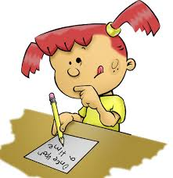
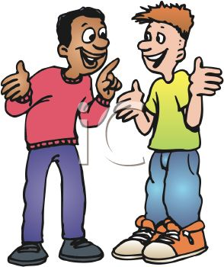
Please Do Now!
On your paper, write what you think is your most important right and why.
Share what you wrote with a partner.
Discuss with the whole group.

